Slide 1


MindSpore And Cloud Native Ecosystem
Zhipeng (Howard) Huang, Huawei
Yedong Liu, Huawei

Slide 2
Contents
01
Introduction of MindSpore
02
MindSpore on Kubernetes
03
Demo

Slide 3



MindSpore Introduction
MindSpore is a new open source deep learning training/inference framework that could be used for mobile, edge and cloud scenarios.
MindSpore is designed to provide development experience with friendly design and efficient execution for the data scientists and algorithmic engineers, native support for Ascend AI processor, and software hardware co-optimization.
At the meantime MindSpore as a global AI open source community, aims to further advance the development and enrichment of the AI software/hardware application ecosystem.
https://www.mindspore.cn
https://www.gitee.com/mindspore
https://www.github.com/mindspore-ai

Slide 4
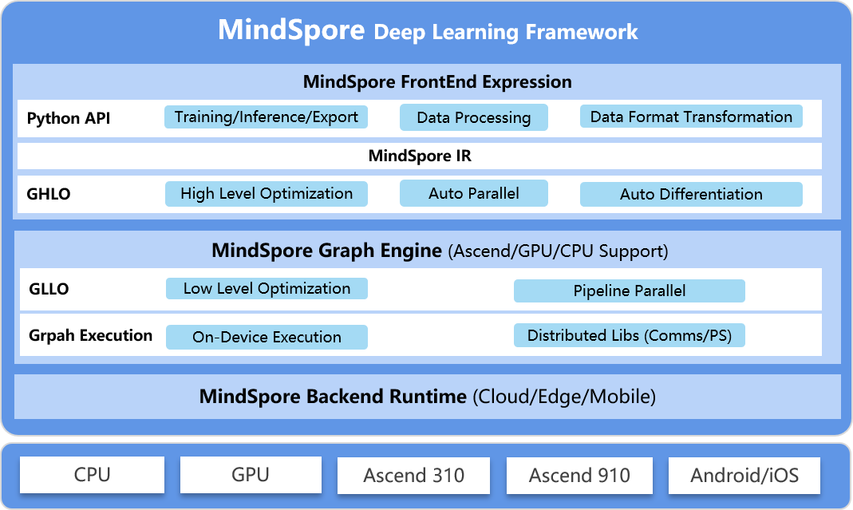
Overview

Slide 5














Technical Steering Committee
14 members from various universities/institutions/companies
that forms an open and global technical governing body

Slide 6
SIG/WG
SIGs
FrontEnd,
Compiler
Executor
ModelZoo
Data
GraphEngine
Visualization
Security
...
WGs
Documentation
Infrastructure
...
Open Developement

Slide 7

Community partners
Open Collaboration

Slide 8
Contents
01
Introduction of MindSpore
02
MindSpore on Kubernetes
03
Demo

Slide 9
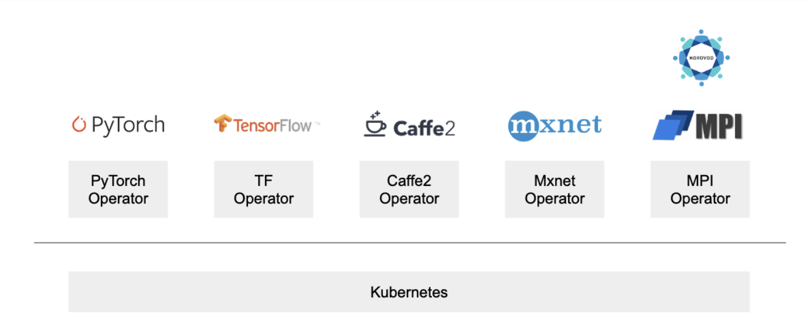
MindSpore on Kubernetes
MindSpore Operator
Using the MindSpore Operator crd, users can install, create and manage ms jobs in Kubernetes cluster easily.

Slide 10
MindSpore in Kubeflow ecosystem
ML tools
MindSpore
other frameworks
Jupyter web app
Metadata
Istio
Jupyter controller
Pipelines
Argo
ms-operator
Kubeflow UI
Kubeflow applications
Prometheus
MPI Operator
KF Serving
other operators
Katib
Seldon Core
Kubernetes
Cloud Platform
Huawei cloud
other cloud service
Hardware
Ascend
CPU
GPU

Slide 11




MS-Operator workflow
ms_job.yaml
Run on cluster with command:
kubectl apply –f ms_job.yaml
Kubeflow
ms-operator
Kind: MSJob
Reference the MSJob definition
Pushing/Pulling container image
crd.yaml
Docker registry
Kubernetes cluster
Kind: CustomResourceDefinition

Slide 12


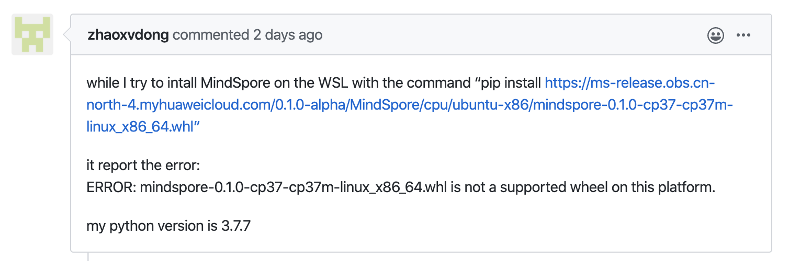
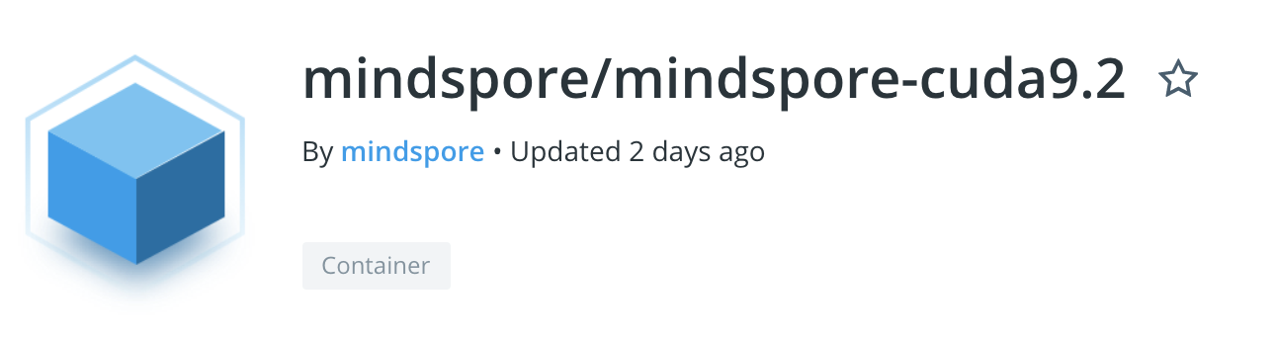
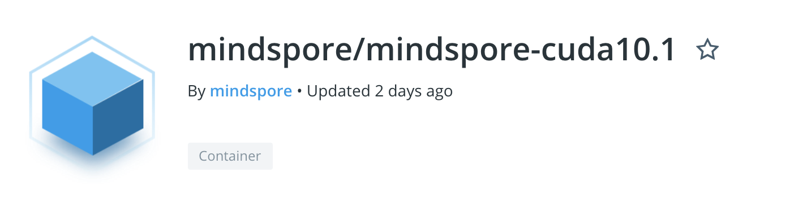
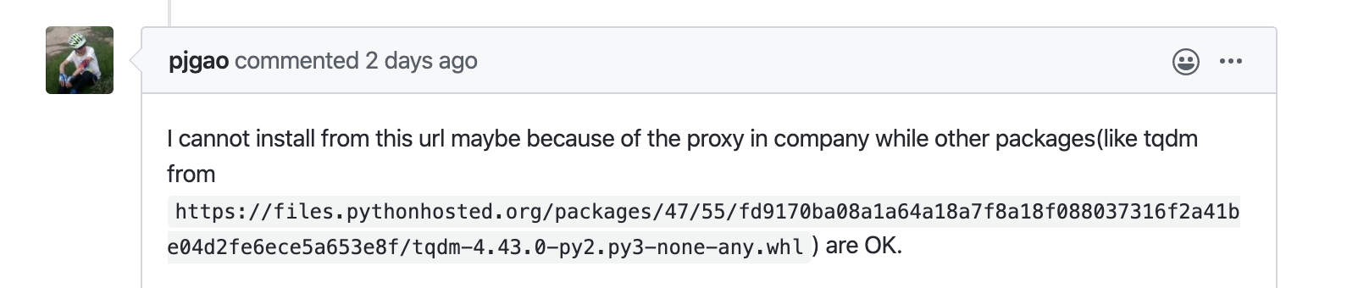
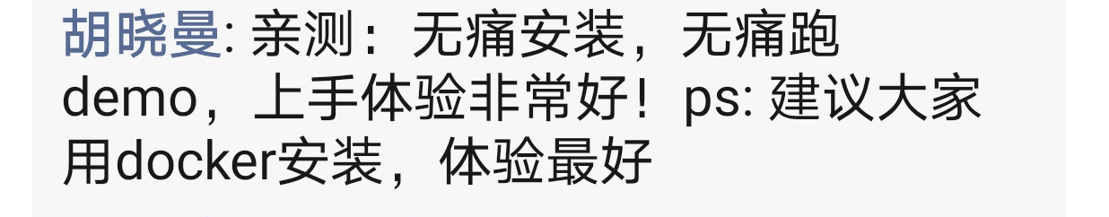
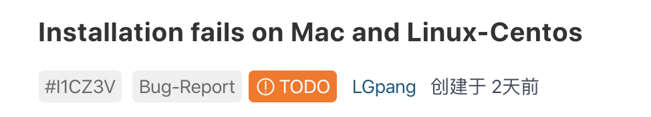
Fun facts——the installing issue
Translation: No pain installing, no pain running demo, the starting experience is fantastic! I strongly recommend everyone installing MindSpore via docker.

Slide 13
Contents
01
Introduction of MindSpore
02
MindSpore on Kubernetes
03
Demo

Slide 14
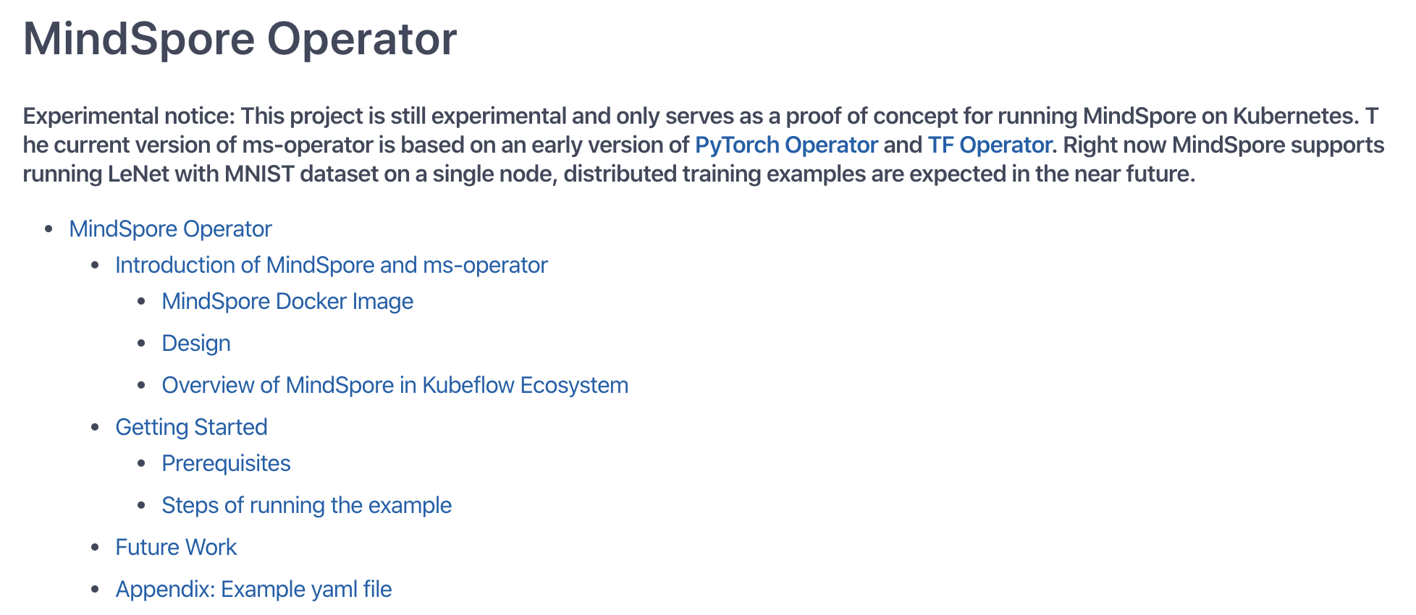
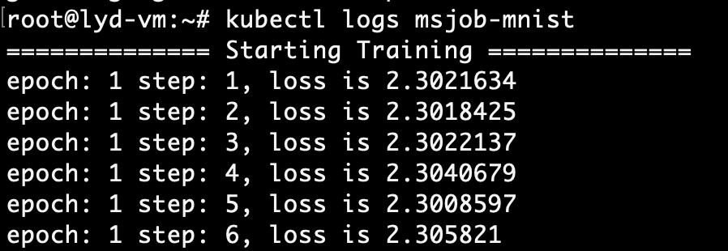
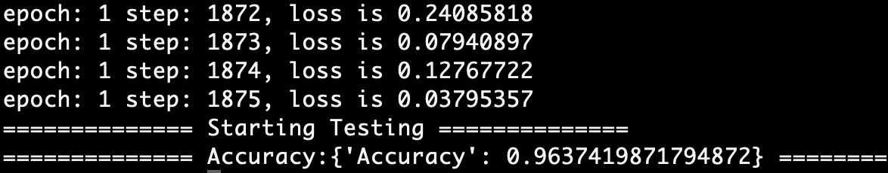
Demo
Goal: Training LeNet with MNIST dataset using MindSpore on a single node in Kubernetes cluster.
Training starts:
Training ends:
https://www.youtube.com/watch?v=P2uXOIct4kg

Slide 15
Call For Participation
Checkout the Code
https://gitee.com/mindspore (main development)
https://github.com/mindspore-ai (mirror)
Try with docker
docker pull mindspore/mindspore-cpu:0.1.0-alpha
docker pull mindspore/mindspore-cuda10.1:0.1.0-alpha
docker pull mindspore/mindspore-cuda9.2:0.1.0-alpha
Discussion
Slack:https://join.slack.com/t/mindspore/shared_invite/enQtOTcwMTIxMDI3NjM0LTNkMWM2MzI5NjIyZWU5ZWQ5M2EwMTQ5MWNiYzMxOGM4OWFhZjI4M2E5OGI2YTg3ODU1ODE2Njg1MThiNWI3YmQ
Mailing list: https://mailweb.mindspore.cn/postorius/lists/mindspore-discuss.mindspore.cn/

Slide 16
THANK YOU
www.mindspore.cn/en

